Slide 1



T20 cricket insights by riad
View in Power BI
Last data refresh:
6/20/2025 6:03:32 AM UTC
Downloaded at:
6/20/2025 6:07:02 AM UTC

Slide 2
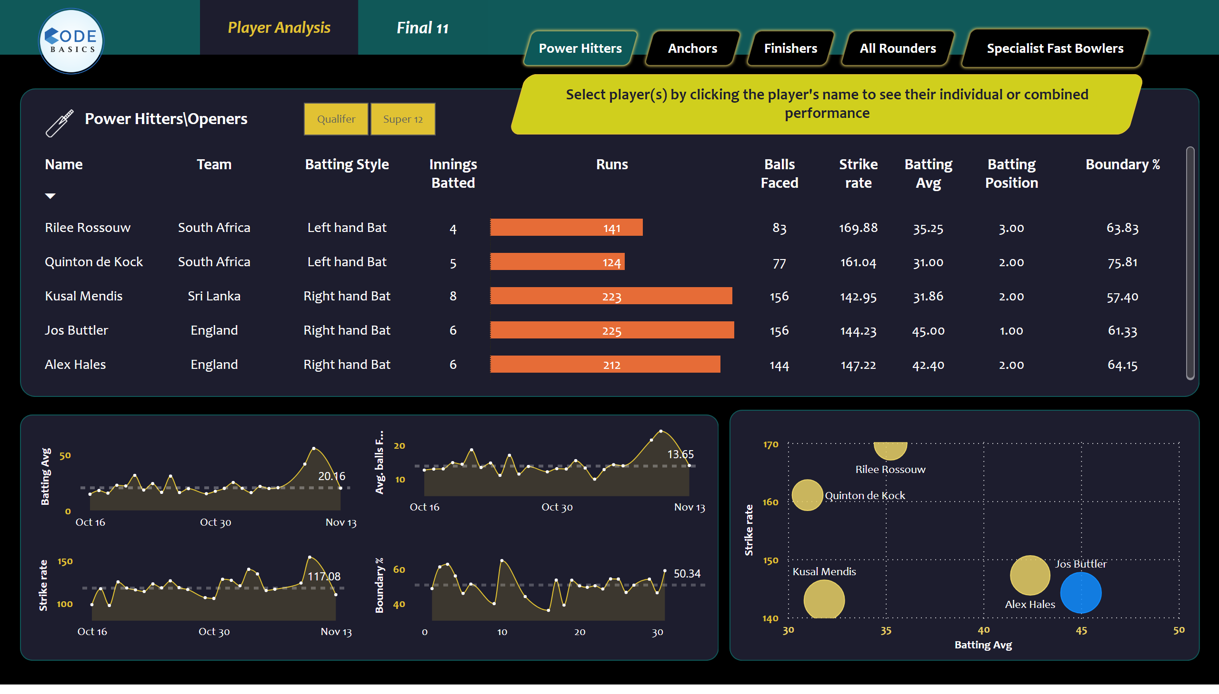
Openar
Notes:
tableEx
No alt text provided
scatterChart
No alt text provided
areaChart
No alt text provided
shape
No alt text provided
shape
No alt text provided
shape
No alt text provided
image
No alt text provided
slicer
No alt text provided
shape
No alt text provided
shape
No alt text provided
shape
No alt text provided
areaChart
No alt text provided
areaChart
No alt text provided
areaChart
No alt text provided
shape
No alt text provided
actionButton
No alt text provided
shape
No alt text provided
shape
No alt text provided
shape
No alt text provided
shape
No alt text provided
shape
No alt text provided
image
No alt text provided
card
No alt text provided
card
No alt text provided
card
No alt text provided
card
No alt text provided
shape
No alt text provided
shape
No alt text provided

Slide 3
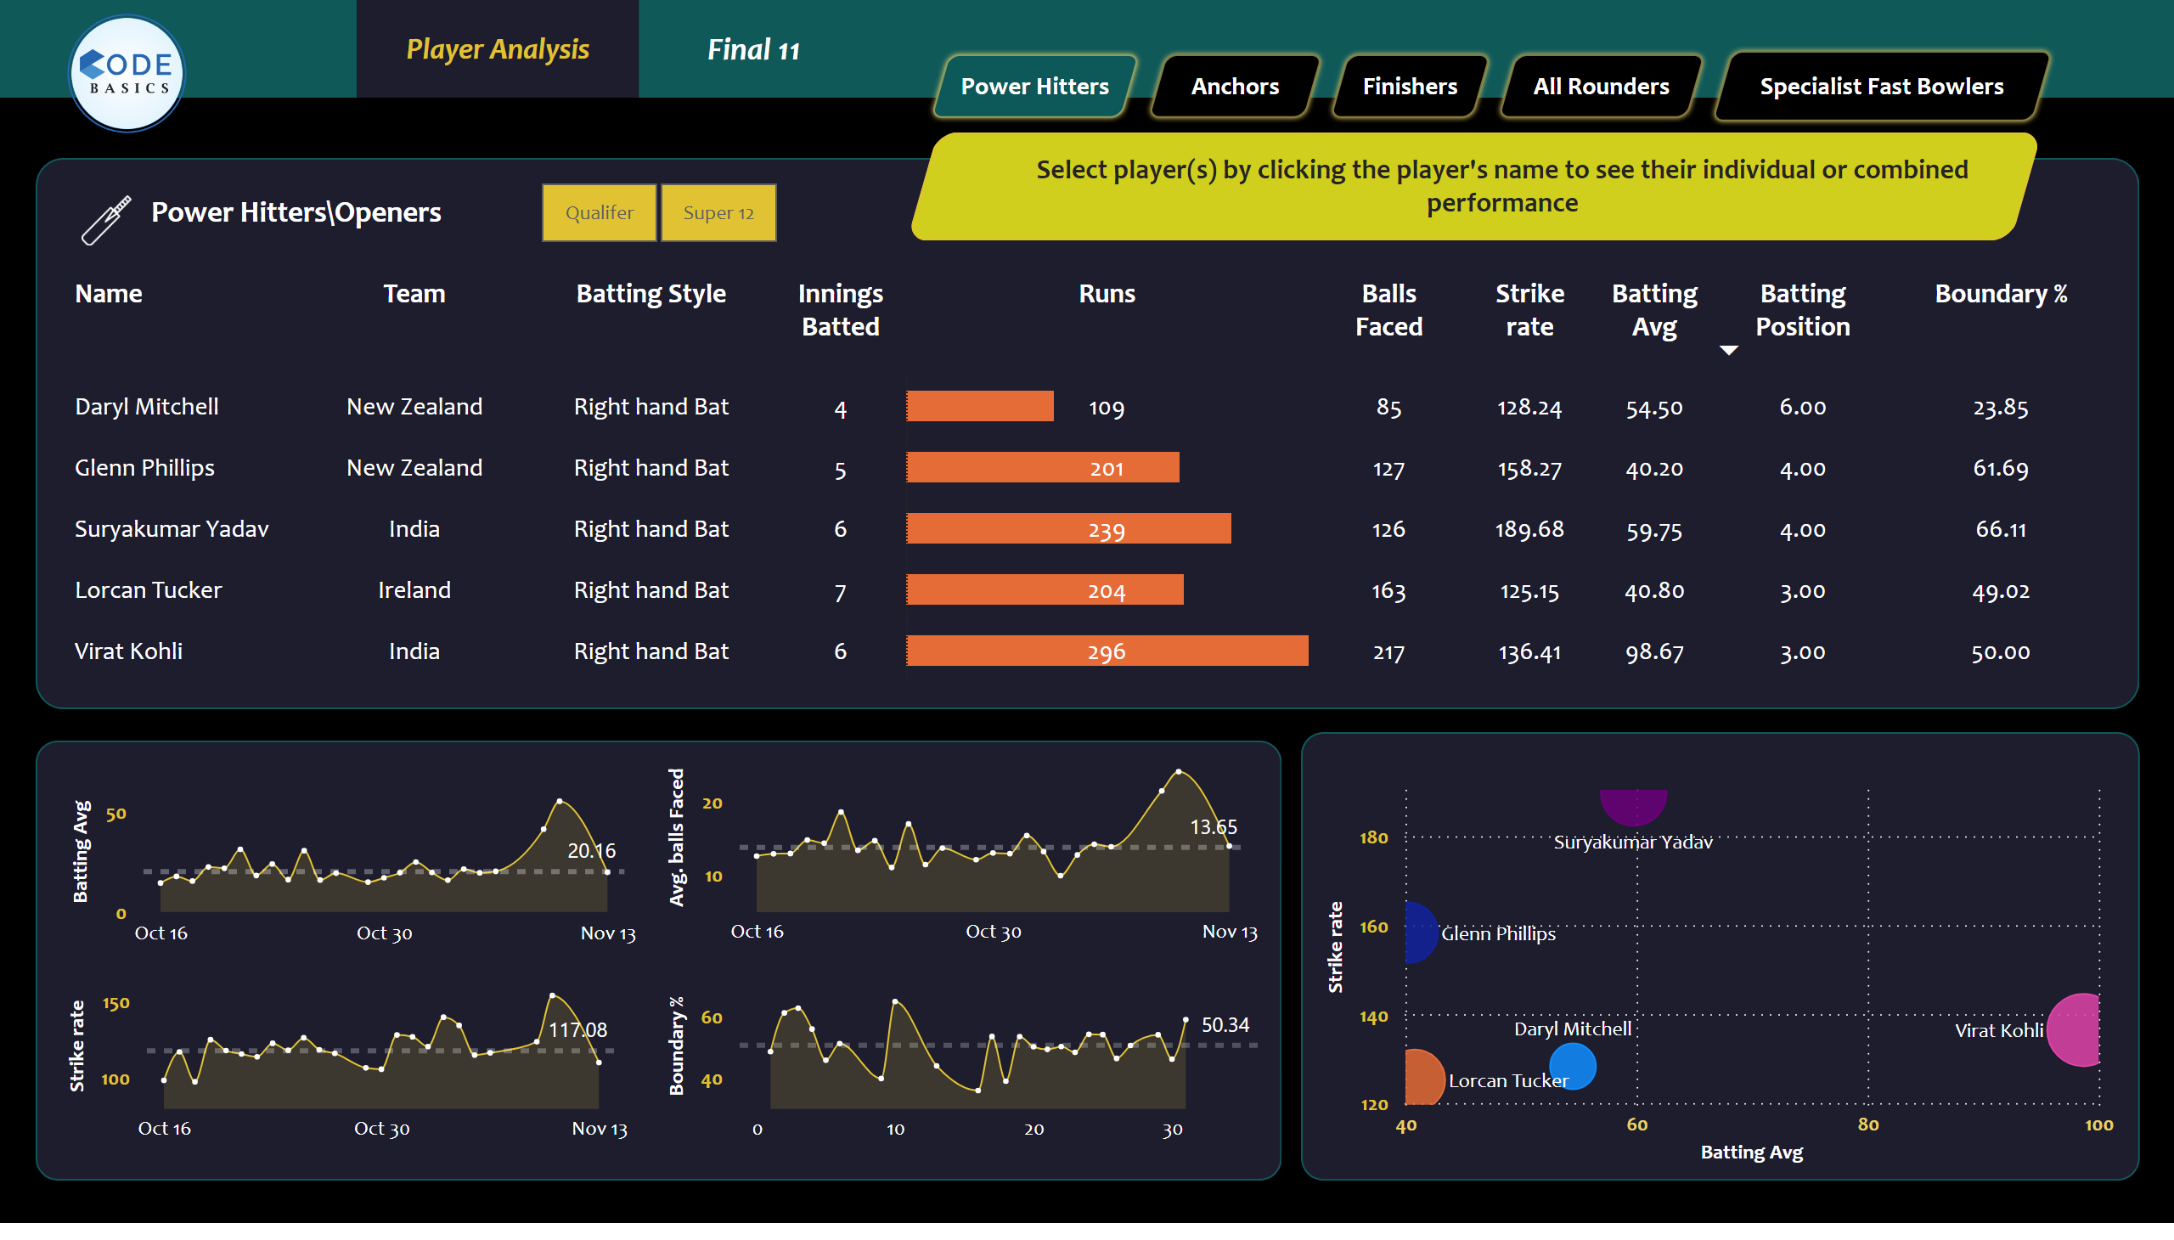
Anchor/middle
Notes:
tableEx
No alt text provided
scatterChart
No alt text provided
areaChart
No alt text provided
shape
No alt text provided
shape
No alt text provided
shape
No alt text provided
image
No alt text provided
slicer
No alt text provided
shape
No alt text provided
shape
No alt text provided
shape
No alt text provided
areaChart
No alt text provided
areaChart
No alt text provided
areaChart
No alt text provided
shape
No alt text provided
actionButton
No alt text provided
shape
No alt text provided
shape
No alt text provided
shape
No alt text provided
shape
No alt text provided
shape
No alt text provided
image
No alt text provided
shape
No alt text provided
card
No alt text provided
card
No alt text provided
card
No alt text provided
card
No alt text provided
shape
No alt text provided

Slide 4
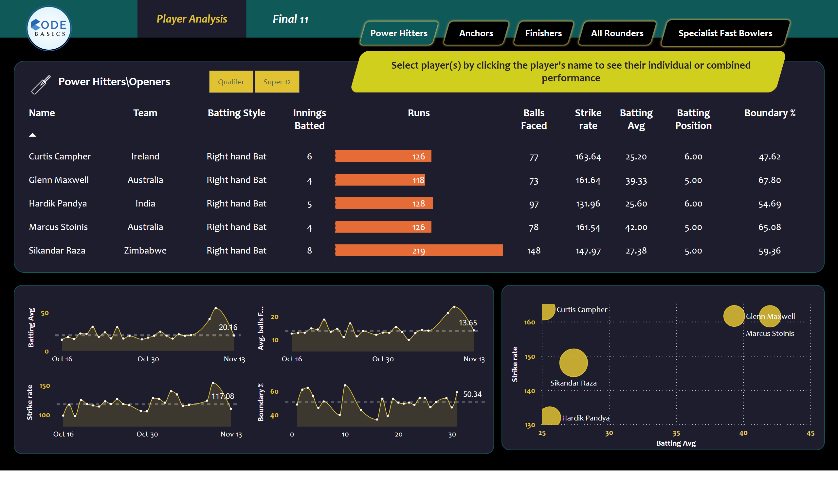
Finishers
Notes:
tableEx
No alt text provided
scatterChart
No alt text provided
areaChart
No alt text provided
shape
No alt text provided
shape
No alt text provided
shape
No alt text provided
image
No alt text provided
slicer
No alt text provided
shape
No alt text provided
shape
No alt text provided
shape
No alt text provided
areaChart
No alt text provided
areaChart
No alt text provided
areaChart
No alt text provided
shape
No alt text provided
actionButton
No alt text provided
shape
No alt text provided
shape
No alt text provided
shape
No alt text provided
shape
No alt text provided
shape
No alt text provided
image
No alt text provided
card
No alt text provided
card
No alt text provided
card
No alt text provided
card
No alt text provided
shape
No alt text provided
shape
No alt text provided

Slide 5
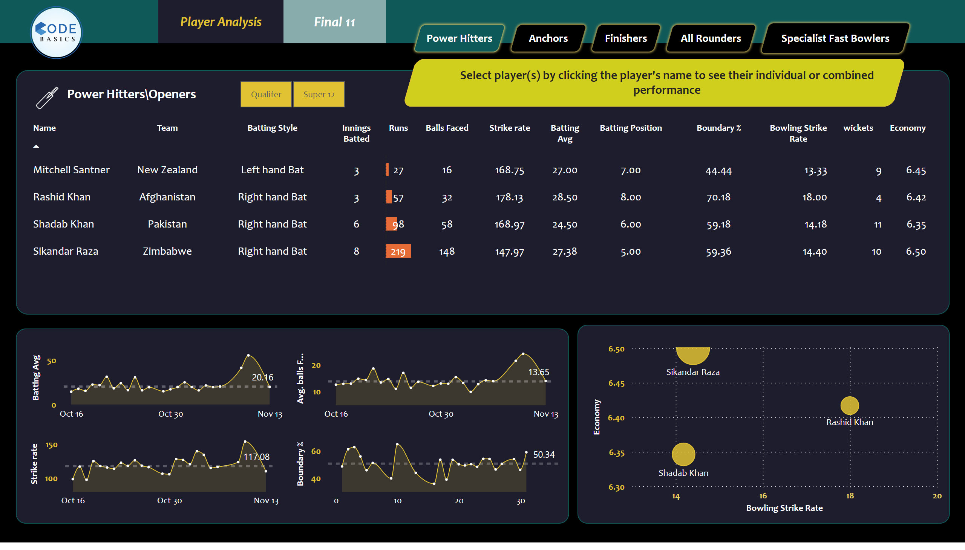
All Rounders
Notes:
tableEx
No alt text provided
scatterChart
No alt text provided
areaChart
No alt text provided
shape
No alt text provided
shape
No alt text provided
shape
No alt text provided
image
No alt text provided
slicer
No alt text provided
shape
No alt text provided
shape
No alt text provided
shape
No alt text provided
areaChart
No alt text provided
areaChart
No alt text provided
areaChart
No alt text provided
shape
No alt text provided
actionButton
No alt text provided
shape
No alt text provided
shape
No alt text provided
shape
No alt text provided
shape
No alt text provided
shape
No alt text provided
image
No alt text provided
shape
No alt text provided
card
No alt text provided
card
No alt text provided
card
No alt text provided
card
No alt text provided
shape
No alt text provided

Slide 6
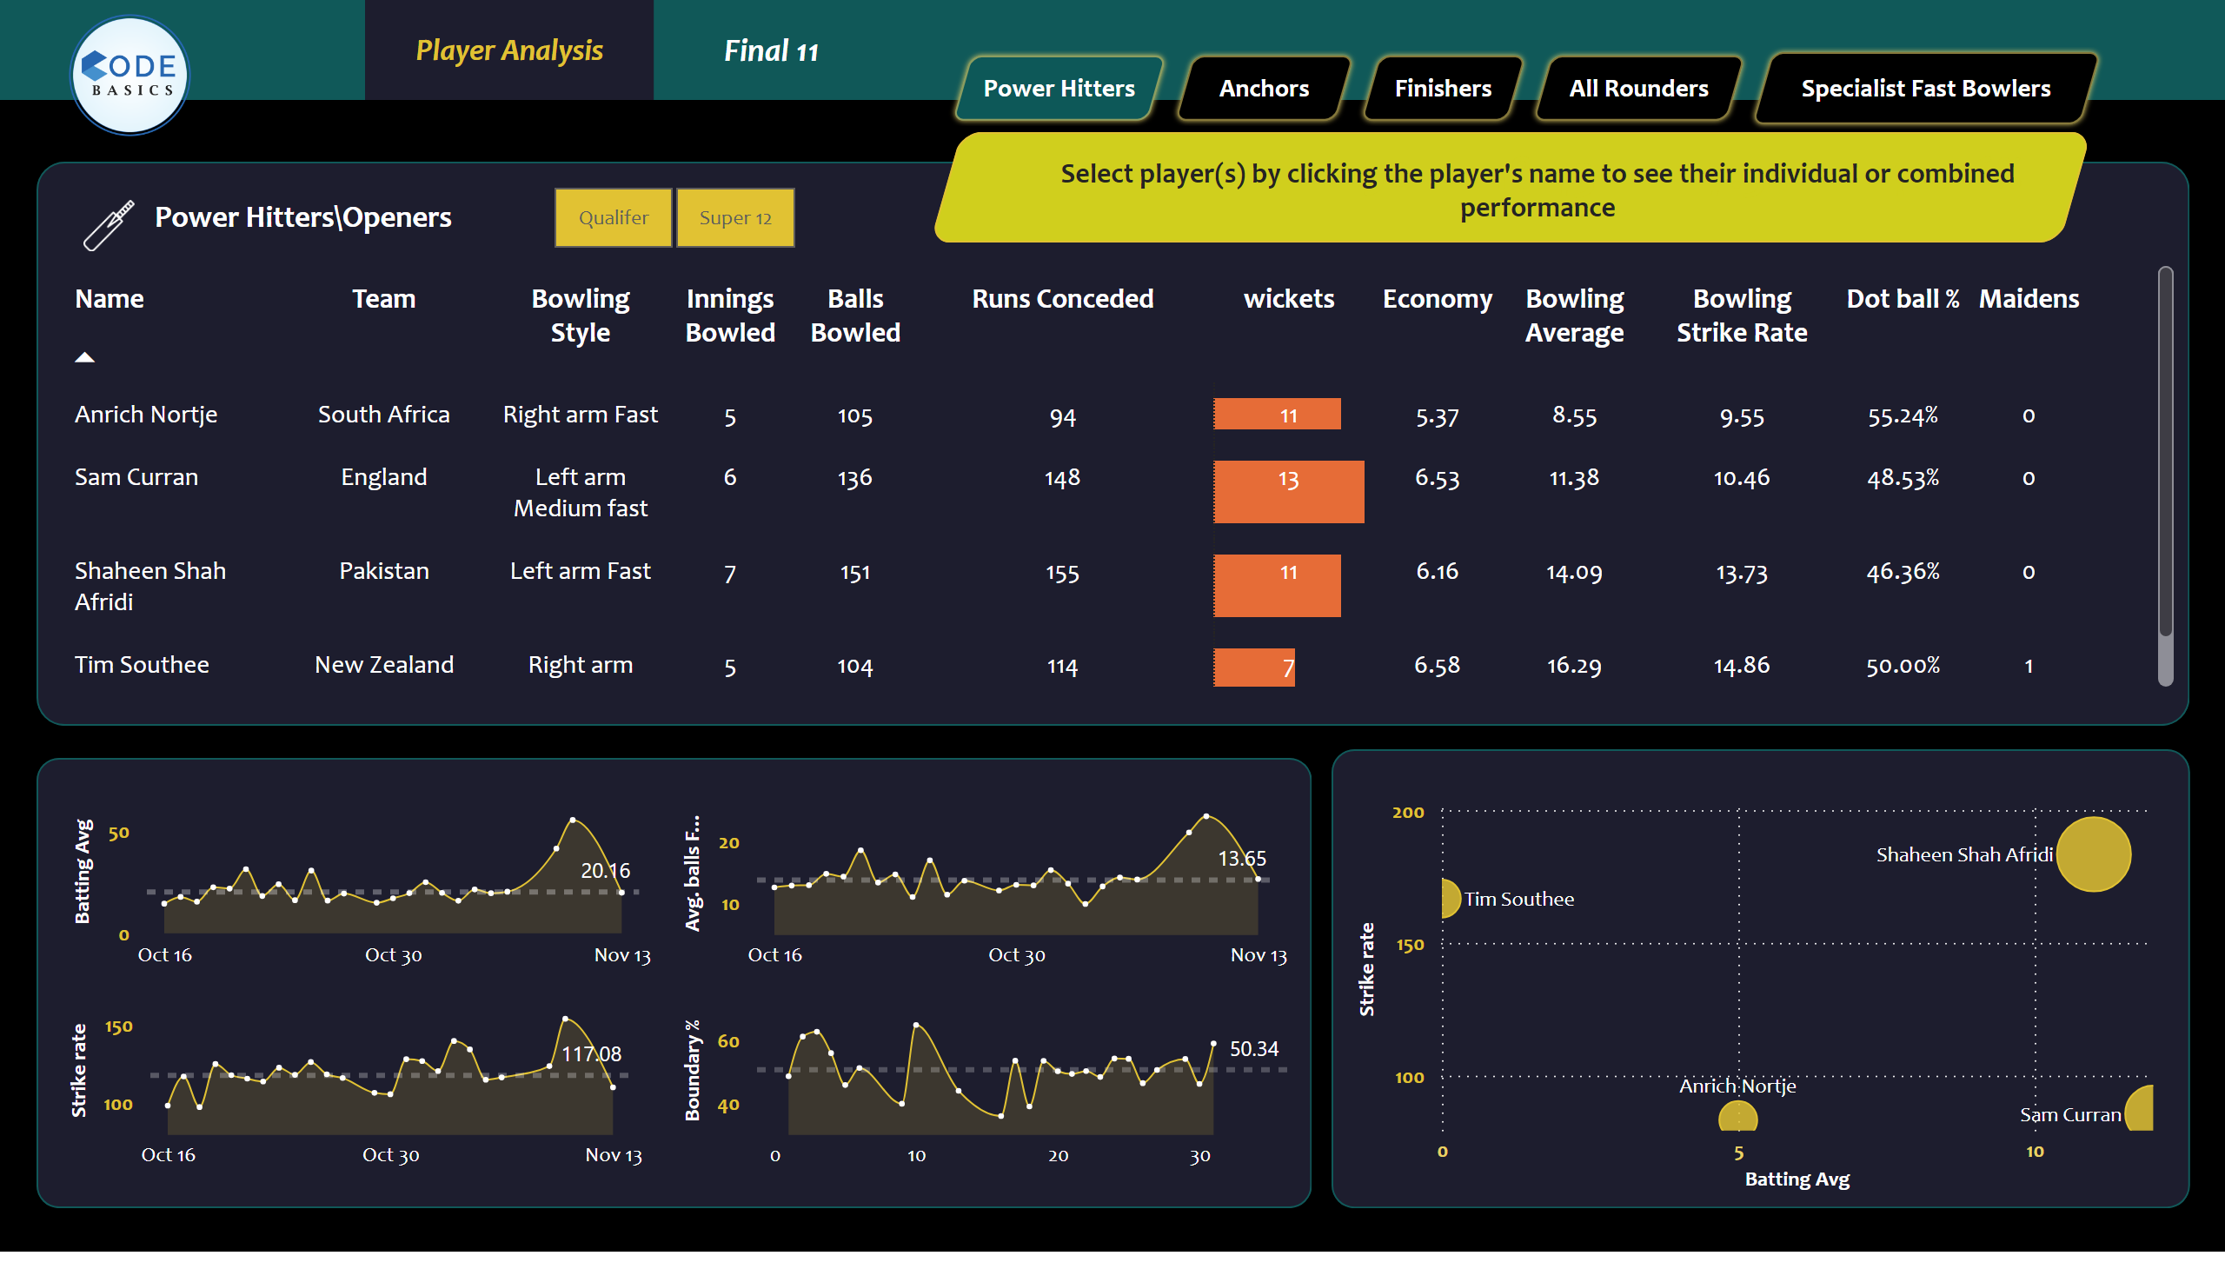
Specialist Fast Bowlers
Notes:
tableEx
No alt text provided
scatterChart
No alt text provided
areaChart
No alt text provided
shape
No alt text provided
shape
No alt text provided
shape
No alt text provided
image
No alt text provided
slicer
No alt text provided
shape
No alt text provided
shape
No alt text provided
shape
No alt text provided
areaChart
No alt text provided
areaChart
No alt text provided
areaChart
No alt text provided
shape
No alt text provided
actionButton
No alt text provided
shape
No alt text provided
shape
No alt text provided
shape
No alt text provided
shape
No alt text provided
shape
No alt text provided
image
No alt text provided
shape
No alt text provided
card
No alt text provided
card
No alt text provided
card
No alt text provided
card
No alt text provided
shape
No alt text provided

Slide 7
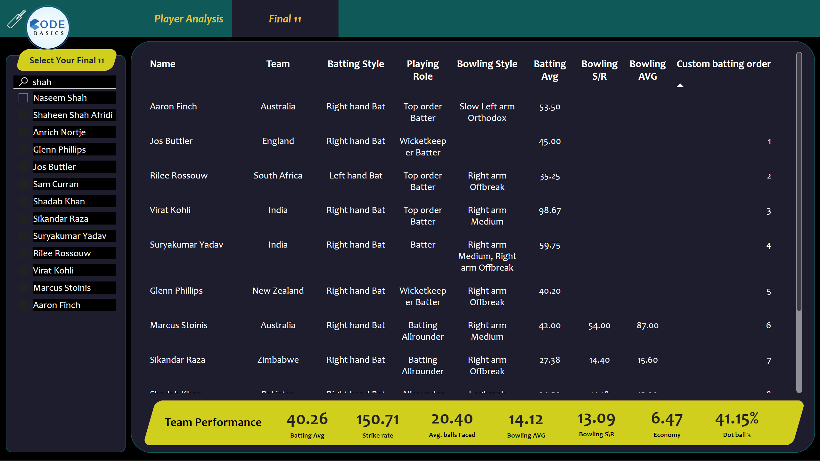
Final 11
Notes:
shape
No alt text provided
shape
No alt text provided
image
No alt text provided
shape
No alt text provided
shape
No alt text provided
image
No alt text provided
shape
No alt text provided
slicer
No alt text provided
tableEx
No alt text provided
shape
No alt text provided
shape
No alt text provided
card
No alt text provided
card
No alt text provided
card
No alt text provided
card
No alt text provided
card
No alt text provided
card
No alt text provided
card
No alt text provided
actionButton
No alt text provided

